Slide 1
Module 3: WaCCliM Roadmap
TRAINING WORKSHOP
ECAM Tool:
Energy performance and Carbon emissions Assessment and Monitoring tool

Slide 2

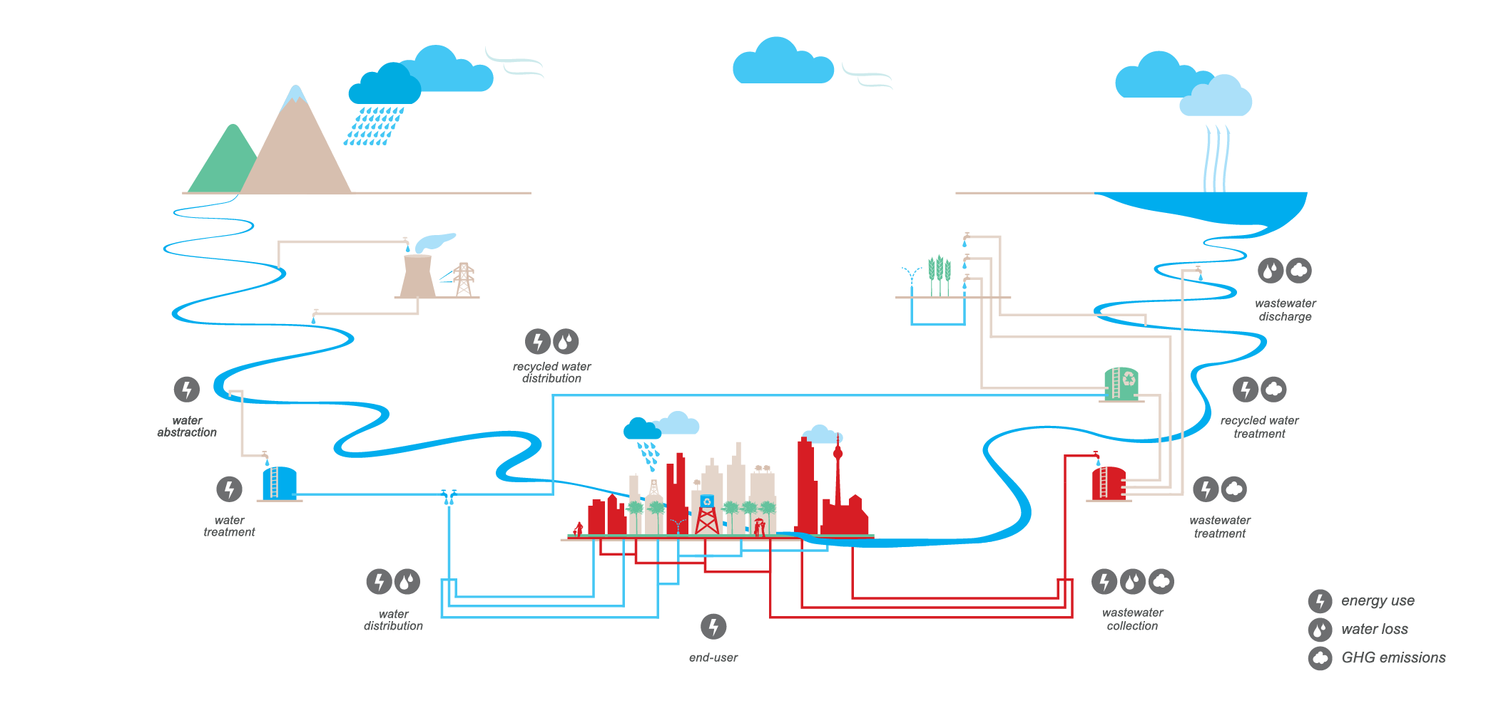
RECALL
Interrelation of climate change and the water cycle
Sources of GHG within the urban water cycle
Module 3: WaCCliM Roadmap

Slide 3

LEARNING OBJECTIVES
Learn how utilities can become carbon neutral following the WaCCliM Roadmap.
State the purpose of each step of the Roadmap and how the step can be implemented
Module 3: WaCCliM Roadmap

Slide 4


CONNECTING THE PIECES
Data
Data
Data
Savings/€
Financing
ECAM
Water Utility
GHG Mitigation
Module 3: WaCCliM Roadmap

Slide 5
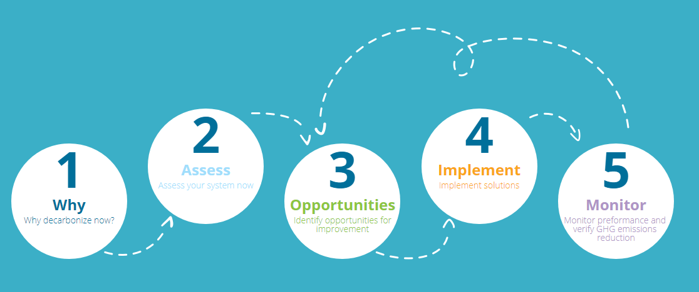
WaCCliM ROADMAP
Module 3: WaCCliM Roadmap

Slide 6

WaCCliM ROADMAP
Why Decarbonise Now?
UNDERSTANDGING DRIVERS FOR DECARBONISATION
Climate change - impacts
National strategies / policy
  Climate change adaptation and mitigation
  Energy efficiency
  Water sector climate change mitigation
Municipal or water utility GHG reduction goals
Module 3: WaCCliM Roadmap

Slide 7
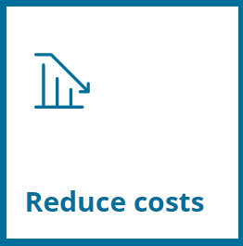

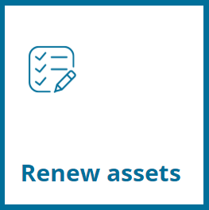

WaCCliM ROADMAP
WHAT IS DRIVING UTILITIES TOWARDS CARBON NEUTRALITY?
SUSTAINABILITY
Module 3: WaCCliM Roadmap
Notes:
Water and wastewater utilities are at the forefront of climate change, as every impact derived from it –more intense and frequent rainfall, sea level rises, or drought – directly affect companies’ operations. Contributing to mitigate the amount of greenhouse gas (GHG) emissions released into the atmosphere by water utilities not only makes economic sense, it’s also an environmentally and socially responsible action to build resilience over the long-term.

Slide 8

WaCCliM ROADMAP
Assess your system
GHG ASSESSMENT
ENERGY PERFORMANCE
WATER EFFICIENCY
Collecting data
Baseline/ starting point with ECAM
The Energy Performance and Carbon Emissions Assessment and Monitoring (ECAM)
Module 3: WaCCliM Roadmap
Notes:
How can you prioritise amongst dozen potential measures to either optimize your system or plan for future assets?
The Energy Performance and Carbon Emissions Assessment and Monitoring (ECAM) tool allows you to assess baseline GHG emissions and where the best opportunities for improvements lie.

Slide 9
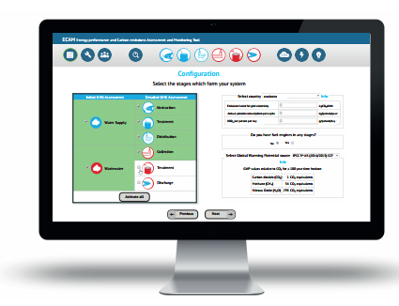
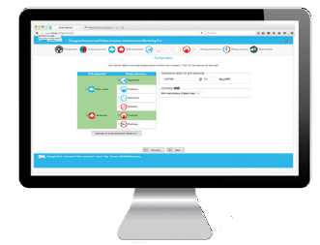
ECAM TOOL: ASSESSING CARBON EMISSIONS
AND ENERGY PERFORMANCE
In a nutshell:
Holistic approach
Low and Middle Income Countries
IPCC methodology
Tiered approach
MRV for the sector
Free, open source
https://wacclim.org/ecam
Baseline assessment
Opportunities
Monitoring
Module 3: WaCCliM Roadmap
Notes:
For utilities: The Energy Performance and Carbon Emissions Assessment and Monitoring (ECAM) tool allows utilities to assess their baseline performance, identify the biggest areas of opportunities and monitor progress. This way utilities can reduce costs from energy, improve their service and contribute to the reduction of greenhouse gasses.
For policymakers/regulators:
The WaCCliM project has developed a carbon and energy accounting tool to invest wisely on our combined water and climate change challenges. The Energy Performance and Carbon Emissions Assessment and Monitoring (ECAM) tool allows carbon accounting for urban services and thus allows the formulation of a carbon reduction strategy in the water sector.

Slide 10

WaCCliM ROADMAP
Identify opportunities for improvement
WHAT ARE THE BIGGEST OPPORTUNITIES?
Options studies:
  Integrated planning:
  Considers master plans and
  whole urban water cycle
Module 3: WaCCliM Roadmap
Notes:
Opportunities can be identified using 1) The ECAM Opportunities calculators to assess the potential of improvements and 2) the Catalogue of solutions on the wacclim knowledge platform allows to evaluate technical options to achieve this improvements.

Slide 11


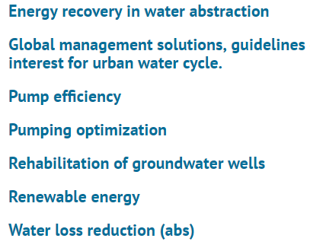
WaCCliM ROADMAP
Opportunities per stage
Impacted by and impacts
Module 3: WaCCliM Roadmap
Notes:
Solutions are provided per stage, but should maintain a holistic view therefore indicated what

Slide 12

WaCCliM ROADMAP
Implement solutions
HOW CAN THE MEASURES BE REALIZED?
Selecting feasible measures
Securing financing:
  Identifying and accessing feasible financing mechanisms
  Preparing a bankable project
Installing measures
Module 3: WaCCliM Roadmap
Notes:
Once alternatives for GHG reduction have been assessed, the ultimate selection should be based on the identification of feasible financing mechanisms for implementing the measures. You can get started on how to prepare bankable projects based on prospective financing, and how to secure financing.

Slide 13
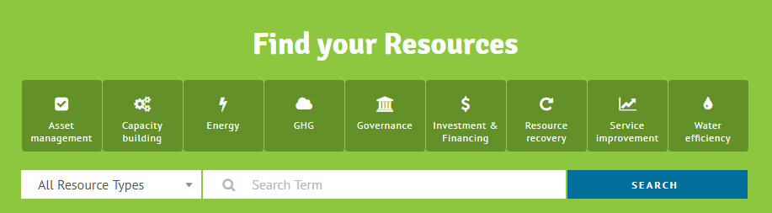
WaCCliM ROADMAP
Find Your Resources
ASSESSING DATA AND MEASURING PROGRESS
Module 3: WaCCliM Roadmap
Notes:
Relevant resources can be found in the libary.

Slide 14

WaCCliM ROADMAP
Monitor performance and verify GHG emissions reduction
ASSESSING DATA AND MEASURING PROGRESS
Need to see how you are doing
Helps confirm impact of measures and continuously identify room for improvement
Module 3: WaCCliM Roadmap
Notes:
With the data framework in place, your system can be monitored using the ECAM-Tool on a quarterly or monthly basis, enabling to report on seasonal variabilities and progress made when optimisation measures are implemented.
- Templates for data collection for specific facilities such as Pumping stations, treatment plants are available.

Slide 15
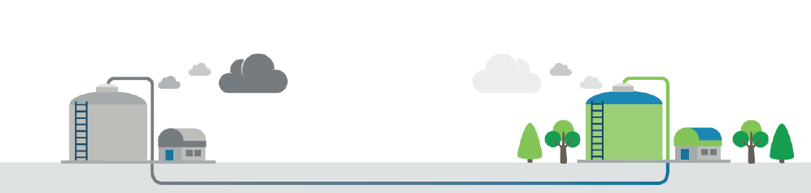
WaCCliM ROADMAP
LONG TERM
Always keep long-term solutions in mind to stay on the road to energy and carbon neutrality
  Rethink current practice and make change when time is right
Planning Future Low Carbon Assets
Energy and Carbon neutrality
Module 3: WaCCliM Roadmap

Slide 16
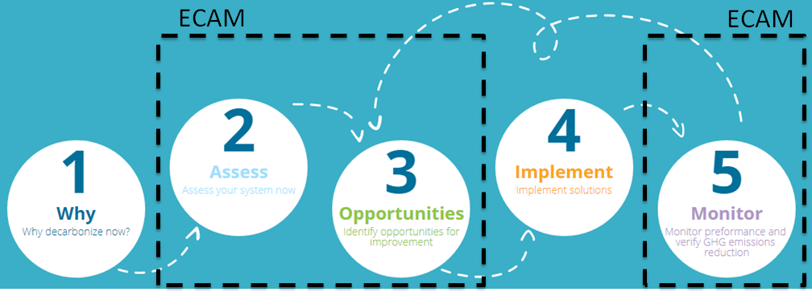
WaCCliM ROADMAP
REQUIREMENT
Needs data management system for continuous implementation of ECAM tool for:
  GHG assessment
  Opportunities
  Monitoring
  Achieving GHG mitigation
Module 3: WaCCliM Roadmap
Notes:
How ecam fits in overall approach. The WaCCliM Roadmap described the approach and key lessons learned .

Slide 17
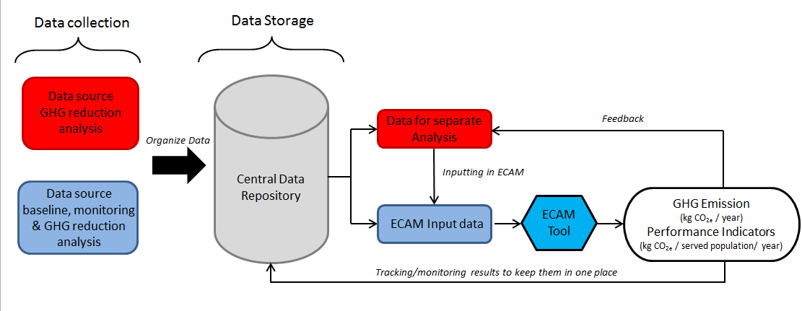
GHG DATA MANAGEMENT AND MITIGATION FRAMEWORK
REQUIREMENT: Needs data management system for continuous implementation of ECAM tool for:
  GHG assessment
  Opportunities
  Monitoring
  Achieving GHG mitigation
Module 3: WaCCliM Roadmap

Slide 18
ECAM AND THE WaCCliM ROADMAP
ECAM tool is simple, water utility friendly, and can provide essential decision support
A robust link between tool and utility data is needed
  Streamlines data retrieval and input for ongoing GHG assessment and mitigation
  Mutual benefits
    Enhances overall utility data management and efficiency
  Facilitates success!
Module 3: WaCCliM Roadmap

Slide 19
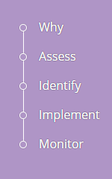
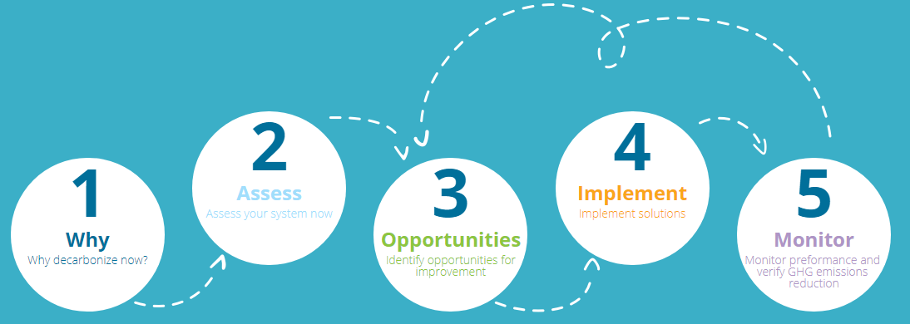
WaCCliM ROADMAP
SUMMARY
ECAM
ECAM
… to reduce the water, energy and carbon footprints.
Module 3: WaCCliM Roadmap

Slide 20

LEARNING EXERCISE
EXERCISE: ROADMAP STEPS
Note down and discuss the following:
Specify the purpose of each roadmap step
What is needed for continuous implementation of ECAM tool and Roadmap?
Module 3: WaCCliM Roadmap

Slide 21

RECAP
Main steps of WaCCliM Roadmap
Prerequisites for successful Implementation of WaCCliM and Roadmap
Module 3: WaCCliM Roadmap

Slide 22
REFERENCES
Coming soon:
Further information on data management
Module 3: WaCCliM Roadmap

