Slide 1
Module 6: Sludge Management
ECAM Tool:
Energy performance and Carbon emissions Assessment and Monitoring tool

Slide 2
RECALL
Interrelation of climate change and the water cycle
Typical emission sources of drinking water and wastewater utilities
Purpose of initial and detailed assessment
Purpose baseline report and important factors for assessing PIs
Link between ECAM, baseline report and WaCCliM Roadmap
Module 6: Sludge Management

Slide 3
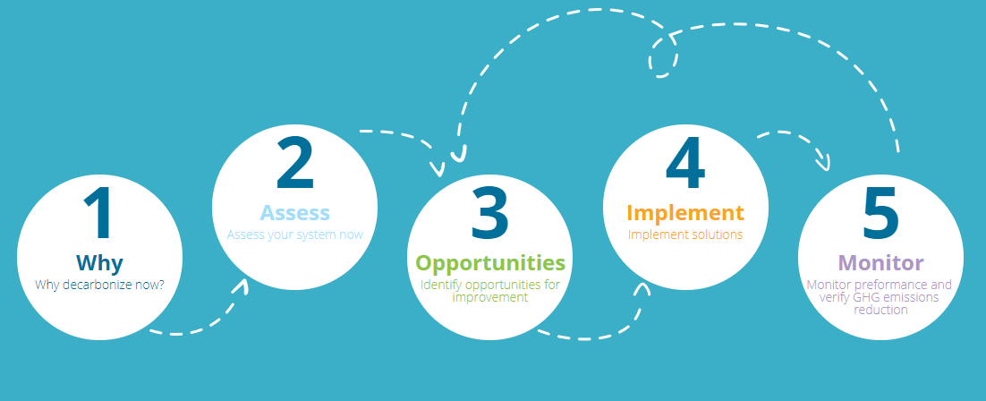
WaCCliM Roadmap
Module 6: Sludge Management

Slide 4
LEARNING OBJECTIVES
Relate sludge management processes to climate change and mitigation
Apply ECAM tool to assess baseline performance
Simulate and compare scenarios to improve sludge management
Module 6: Sludge Management

Slide 5
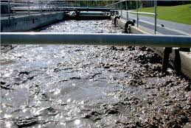
SLUDGE MANAGEMENT IN A NUTSHELL
Sludge management relates to all operations aiming at treating sludge that is produced in WWTPs
Residual, semi-solid by-product material from WWTPs
Related operations can add up to 50% of total operation costs
Risks for pathogenic microorganisms
Treatment goals: reduce volume and costs, reuse
Module 6: Sludge Management

Slide 6
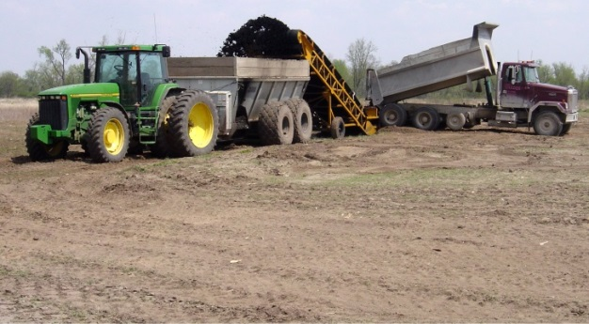
SLUDGE MANAGEMENT IN A NUTSHELL
INSIDE VS OUTSIDE FENCE
Two types of processes are distinguished:
Primary and secondary inside the fence of the WWTP for energy production or feedback processes
“Waste” Sludge is disposed of, thus outside the fence, overstepping the boundaries of the WWTP
INSIDE THE FENCE
OUTSIDE THE FENCE
FOCUS IN ECAM V2.0 IS ON DIRECT GHG EMISSIONS INSIDE AND OUTSIDE THE FENCE
Module 6: Sludge Management

Slide 7
SLUDGE MANAGEMENT IN A NUTSHELL
SIMPLIFIED PROCESSES OF WWTP
INSIDE THE FENCE
UNIT PROCESS DESCRIPTION
EFFECTS
Primary Clarification
Biological Treatment
Secondary Clarification
Thickening
Dewatering
Storage
Digestion
Incineration
Disposal
Settling tanks for continuous removal of solids
Reduce BOD Load
Reduce TSS Content
Reactors employing microorganisms to break down organic matter
Reduce BOD/nutrient Load
Reduce TSS Content
Removal of flocs created during certain biological treatments
Reduce BOD Load
Reduce TSS Content
Increase of the sludge density
Reduce Sludge Volume
Refine Sludge Structure
Water removal from sludge
Reduce Sludge Volume
Increase Solid Fraction
Storage before further treatment steps
Anaerobic treatment of sludge
Reduce BOD Load
Reduce Volume
Thermal destruction of sludge
Reduce Volume
Final destination of the waste product
Module 6: Sludge Management

Slide 8
IMPACT ON CLIMATE CHANGE
WHAT’S THE LINK?
SLUDGE MANAGEMENT OPERATIONS
GHG EMISSIONS
Sludge is produced as a waste material in WTTPs
Sludge management requires energy, thus emitting CO₂ at different steps
Choice of disposal technique greatly affects the amount of emissions
Choice of handling and ultimate disposal techniques determine opportunities for resource recovery and minimized GHG emissions
When possible, it is crucial to implement reuse and resource valorization
SLUDGE AS A RESOURCE RATHER THAN WASTE
Module 6: Sludge Management

Slide 9
IMPACT ON CLIMATE CHANGE
TYPICAL EMISSIONS FOR SINGLE PROCESSES
PROCESSES
EMISSIONS in ECAM V2.0
Primary Clarification
Biological Treatment
Secondary Clarification
Thickening
Dewatering
Storage
Digestion
Incineration
Disposal
CH₄
N₂O
CO₂ (included in kWh consumed by WWTP)
CO₂ (included in kWh consumed by WWTP)
CH₄
CH_{4,} CO₂ (included in kWh consumed by WWTP)
N₂O, CO₂ (included in kWh consumed by WWTP)
CH₄
N₂O
CO₂ from transportation to disposal
Module 6: Sludge Management

Slide 10
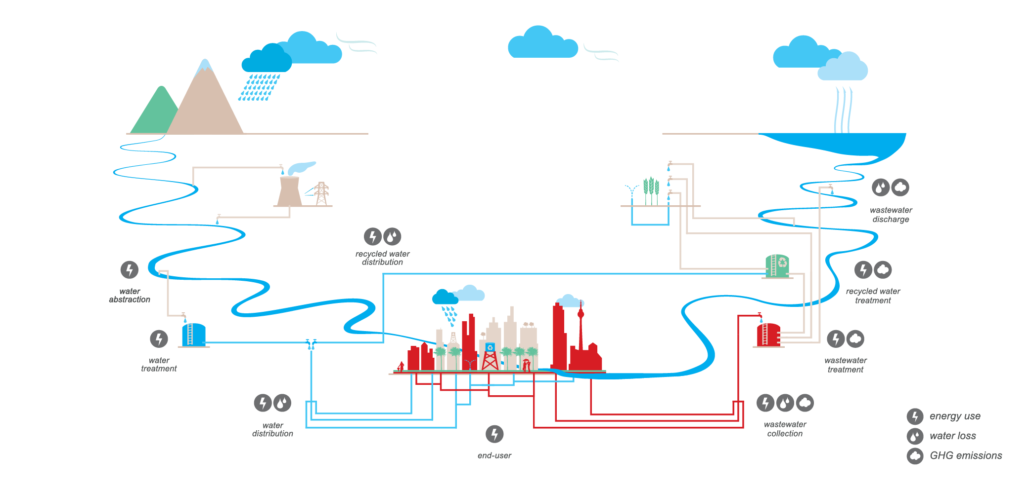
IMPACT ON CLIMATE CHANGE
SLUDGE MANAGEMENT AND THE URBAN WATER CYCLE
Adopting a holistic approach to improve sludge management…
Module 6: Sludge Management
Notes:
The holistic approach is relevant when assessing sludge management (e.g. Relation digestion and sludge volume that requires treatment, impact on emissions of reduced inflow and infiltration)

Slide 11
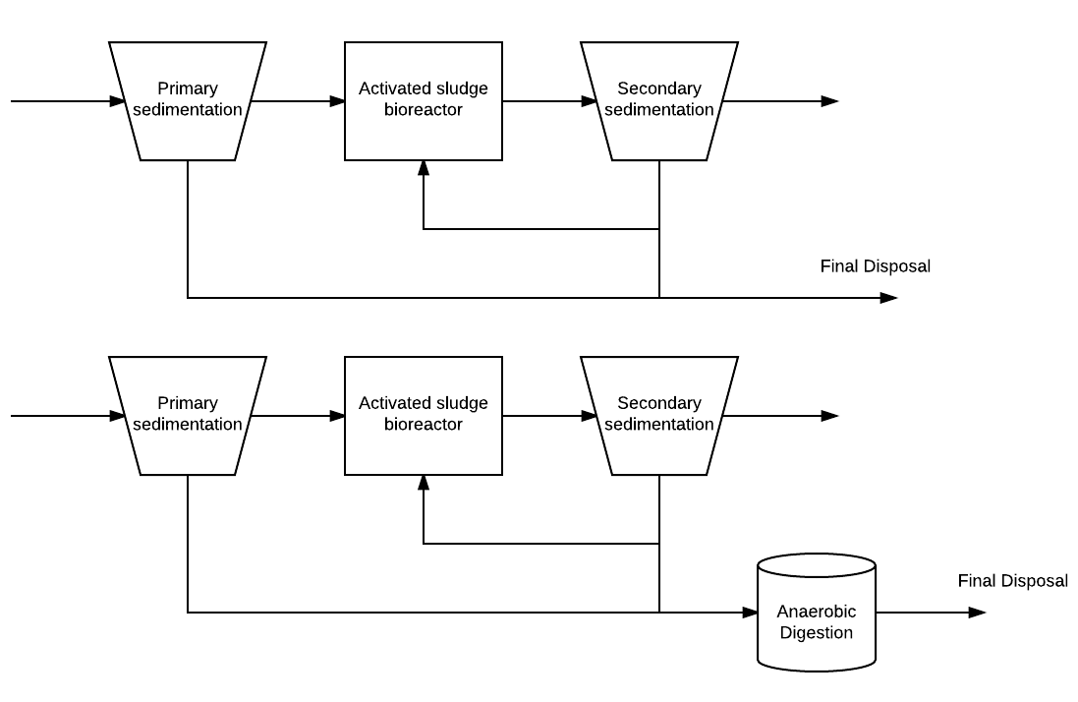
ASSESSING GHG AND ENERGY PERFORMANCE
First, let's understand distinction between non-digested and digested sludge
non-digested sludge
More volume
More carbon content
digested sludge
Less volume
Less carbon content
Module 6: Sludge Management

Slide 12
ASSESSING GHG AND ENERGY PERFORMANCE
Tier A - Initial GHG Assessment in ECAM
Sludge production estimation versus actual numbers in detailed assessment
Assumes 4% solids in waste sludge for dry weight calculation
70% volatile solids for non-digested
51% volatile solids for digested
Select disposal method
Module 6: Sludge Management

Slide 13
ASSESSING GHG AND ENERGY PERFORMANCE
Tier B - Detailed GHG Assessment in ECAM
Sludge production based on actual numbers:
However, if sludge wet and dry weight are not known:
Assumes 4% solids in waste sludge for dry weight calculation; however, if centrifuge and/or chemical condition specified, 20% solids is assumed.
70% volatile solids for non-digested
51% volatile solids for digested
Disposal Method
Now can choose any combination of methods, not just one as for initial assessment
Differentiates between coarse-textured and fine-textured soils for Land Application
Activity info for emissions from truck transport now specified
Sludge storage methane emissions now accounted for if there is storage
Module 6: Sludge Management

Slide 14
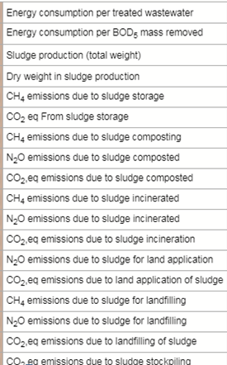
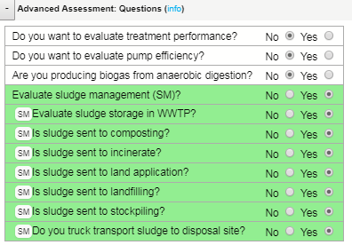
ASSESSING GHG AND ENERGY PERFORMANCE
Module 6: Sludge Management

Slide 15
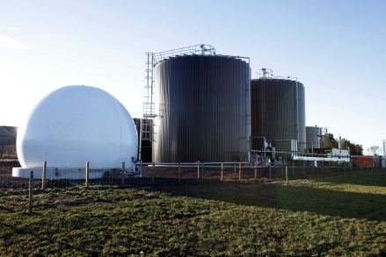
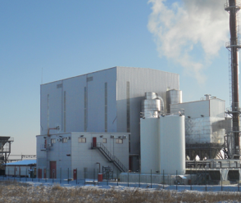
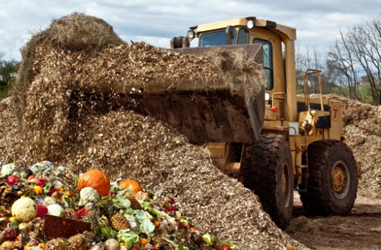
OPPORTUNITIES
MITIGATION OF EMISSIONS
Inside fence - Improve energy efficiency and biogas production/valorization to reduce kWh & GHG emissions
Outside fence - Taking advantage of opportunities for alternate disposal options that allow resource recovery and cause less GHG emissions:
ANAEROBIC DIGESTION
INCINERATION
SLUDGE DISPOSAL
Landfill Gas recovery
Nutrient recovery
(composting, land application)
Biogas valorization
Heat recovery
SLUDGE DISPOSAL
Module 6: Sludge Management

Slide 16
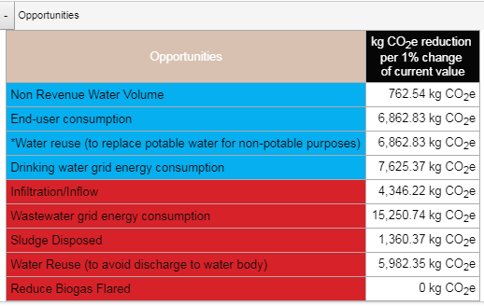
OPPORTUNITIES
MITIGATION OF EMISSIONS
Potential to reduce emissions depends on improvement measure
Examples Utility A – 30,591 kg (dry weight) sludge per year
Composting and Land Application Overall emission reduction of up to 93% compared to landfilling Main differences: emission factors and resource recovery
Take home: Landfill with biogas recovery is best option since there would be no methane emissions
Module 6: Sludge Management
Notes:
Land application: Emissions factors vary according to the soil typology. ECAM differentiates between coarse-textured and fine-textured soils.

Slide 17
LEARNING EXERCISE
EXERCISE: COMPARING EMISSIONS
Picture a hypothetical municipal wastewater treatment plant.
Match each unit process with its likely emission value.
Assume a primary sludge mass of 30 tons and a biogas production of 20000 m³. Amount of biogas flared is 5000 m³
Refer to equations in manual
Process
Storage 5 days - CH₄
Incineration - CH₄
Flaring - CH₄
Landfilling - CH₄
Composting - CH₄
Emissions [kg]
40
5500
1
500
2000
Module 6: Sludge Management

Slide 18
RECAP
How does sludge management contribute to climate change?
Difference inside and outside the fence processes, and link holistic urban water cycle approach
Resource recovery by land application/composting
Biogas production and valorization (inside and outside)
4 key improvement measures and their relative impact
Module 6: Sludge Management

