Slide 1
Module 6: Water Efficiency
ECAM Tool:
Energy performance and Carbon emissions Assessment and Monitoring tool

Slide 2
RECALL
Interrelation of climate change and the water cycle
Typical emission sources of drinking water and wastewater utilities
Purpose of initial and detailed assessment
Purpose baseline report and important factors for assessing PIs
Link between ECAM, baseline report and WaCCliM Roadmap
Module 6: Water Efficiency

Slide 3
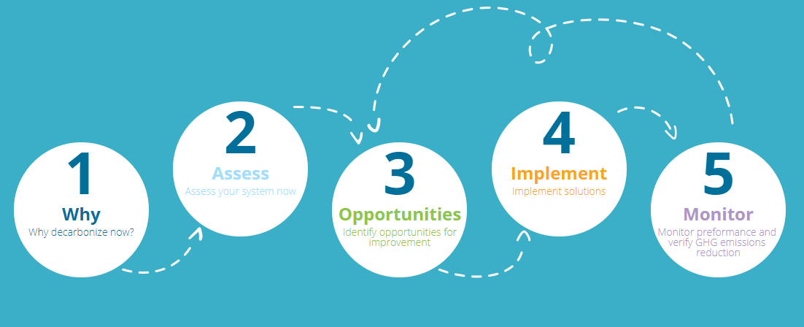
WaCCliM Roadmap
Module 6: Water Efficiency

Slide 4
LEARNING OBJECTIVES
Understand what is water efficiency
The role of water efficiency in climate change mitigation and adaptation
How to use ECAM tool to assess:
water efficiency throughout the urban water cycle
opportunities for improving water efficiency and reducing related GHG emissions
How implementing water efficiency related measures to reduce GHG emissions fits within the WaCCliM Roadmap
Module 6: Water Efficiency

Slide 5
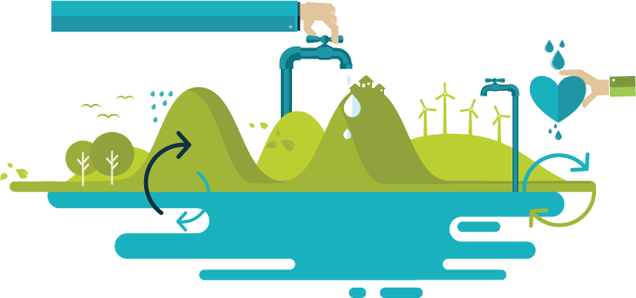
What is water efficiency?
Water efficiency can be broken down into 3 actions that are all interrelated:
Reducing wasteful use of water
Producing and using the right water for the right purpose
Conveying and treating only the water that you need to convey and treat
Module 6: Water Efficiency

Slide 6
What is water efficiency?
Reducing wasteful use of water
Module 6: Water Efficiency

Slide 7
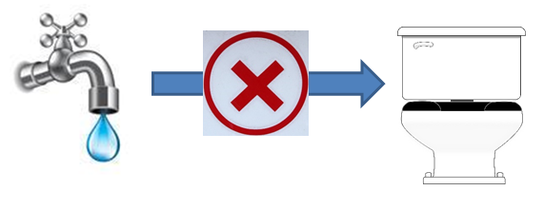
What is water efficiency?
Producing and using the right water for the right purpose
Why is this important?
Producing potable (drinking water quality) water is costly and energy intensive; therefore, if other lesser quality water (i.e. water reuse, rainwater, etc.) can be used for non-potable purposes, it is always better.
Module 6: Water Efficiency

Slide 8
LEARNING EXERCISE
Exercise 1: Producing and using the right water for the right purpose
Match the right water with the right purpose
(the same water can be matched to multiple purposes and purposes can be matched by more than one type of water)
Type of Water
Potable water
Rain water
Recycled water via semi-advanced treatment
Recycled water via most advanced treatment
Purpose
Landscape irrigation
Direct potable reuse source water
Drinking water
Indirect potable reuse source water
Toilet flushing
Module 6: Water Efficiency

Slide 9
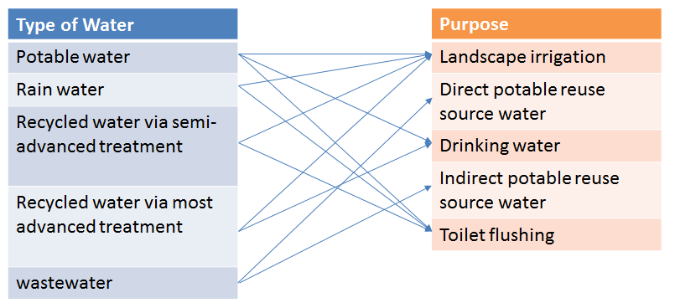
LEARNING EXERCISE 1
Exercise 1: Answer
Module 6: Water Efficiency

Slide 10
What is water efficiency?
Conveying and treating only the water that you need to convey and treat
Why is this important?
Conveying and treating potable water and wastewater is costly and energy intensive; therefore, you do not want to convey and treat more than you need to.
Module 6: Water Efficiency

Slide 11
LEARNING EXERCISE
Exercise 2: Conveying and treating only the water that you need to convey and treat
Name at least one measure to accomplish this for drinking water and wastewater
Module 6: Water Efficiency

Slide 12
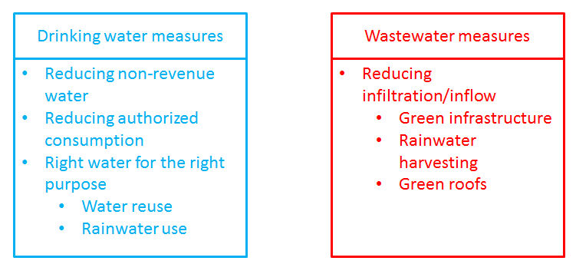
LEARNING EXERCISE
Exercise 2: Answer
Module 6: Water Efficiency

Slide 13
2. The role of water efficiency in climate change mitigation
Producing potable (drinking water quality) water is costly and energy intensive; therefore, if other lesser quality water (i.e. water reuse, rainwater, etc.) can be used for non-potable purposes, it is always better.
Conveying and treating potable water and wastewater is costly and energy intensive; therefore, you do not want to convey and treat more than you need to.
Grid energy consumption (kWh) = CO₂ emissions
EF = kg CO2e / kWh
Therefore, being more water efficient results in less energy consumption from less pumping and less treatment, less GHG emissions, and CC mitigation
Module 6: Water Efficiency

Slide 14
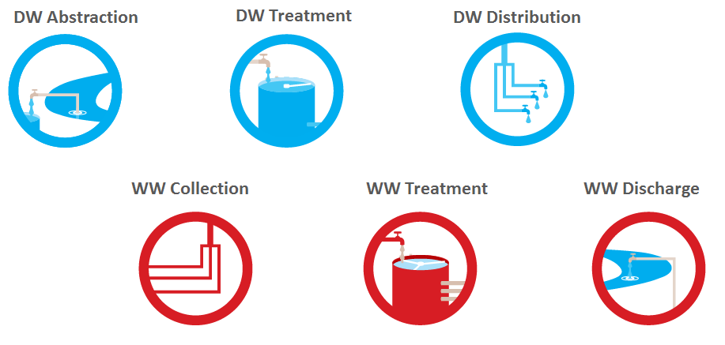
LEARNING EXERCISE
Exercise 3: The role of water efficiency in climate change mitigation
List the water efficiency GHG-related emissions for each stage of the urban water cycle below and their sources and influencing factors:
Module 6: Water Efficiency

Slide 15
LEARNING EXERCISE
Exercise 3: Answer
DW Abstraction
DW Treatment
GHG type | Source | Factors
kWh CO₂ | Pumping, equip. | Auth. Consumption, Non-revenue water
GHG type | Source | Factors
kWh CO₂ | Pumping, process, equip | Auth. Consumption, Non-revenue water
DW Distribution
GHG type | Source | Factors
kWh CO₂ | Pumping, equip | Auth. Consumption, Non-revenue water
Module 6: Water Efficiency

Slide 16
LEARNING EXERCISE
Exercise 3: Answer
WW Collection
WW Treatment
GHG type | Source | Factors
kWh CO₂ | Pumping, equip. | Auth. Consumption, infiltration/ inflow
GHG type | Source | Factors
kWh CO₂ | Pumping, process, equip | Auth. Consumption, Infiltration/ inflow
WW Discharge
GHG type | Source | Factors
kWh CO₂ | Pumping, equip | Auth. Consumption, Inf./Inf.
N₂O | Receiving water | N in effluent
Module 6: Water Efficiency

Slide 17
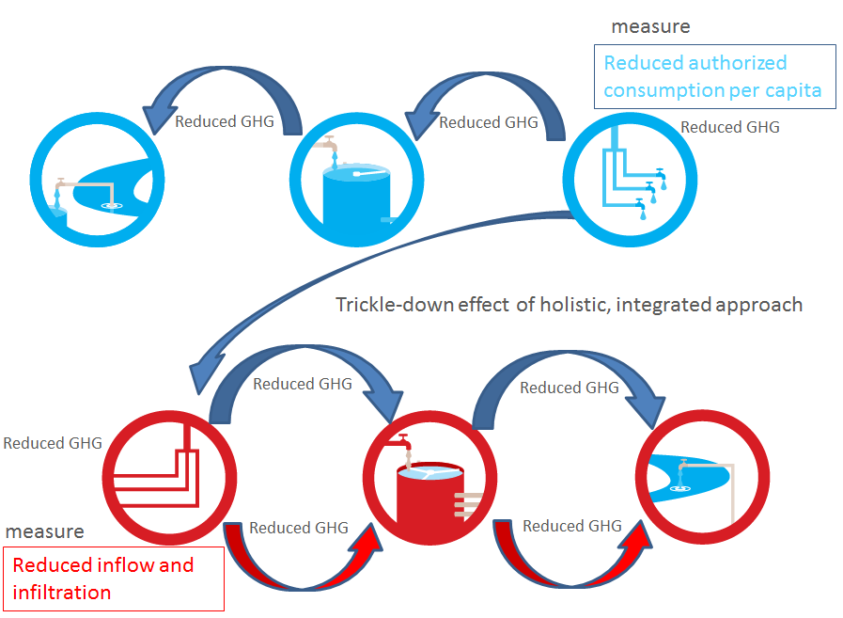
The role of water efficiency in climate change mitigation: Conclusion
Module 6: Water Efficiency

Slide 18
Assessing water efficiency in ECAM tool
What is the single most important parameter in evaluating water efficiency?
Answer: Volume, m³
All water efficiency related GHG emissions will be based upon volume:
Volume abstracted (pumped)
Volume treated
Volume distributed/collected (pumped)
Volume discharged (pumped)
And will be driven by
Volume of authorized consumption
Volume of non-revenue water
Volume of infiltration/inflow
Module 6: Water Efficiency

Slide 19
Assessing water efficiency in ECAM tool
Since all water efficiency related GHG emissions can be traced to energy consumption, a key indicator to track across the urban water cycle is kWh/m³. Therefore, knowing volume, energy consumption, and CO₂e/kWh grid energy emission factor, one can calculate water efficiency related GHG remissions.
So let’s take a look at where we can track water efficiency and kWh/m³ in ECAM to assess water efficiency related GHG emissions
Load WE .json file (Slides 20 – 26 will be interactive with tool)
Module 6: Water Efficiency

Slide 20
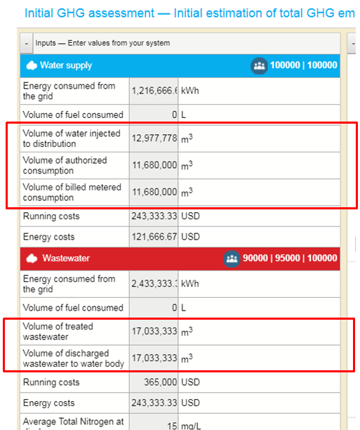
Assessing water efficiency in ECAM tool
Module 6: Water Efficiency

Slide 21
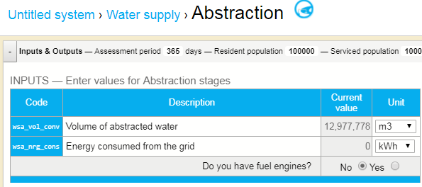
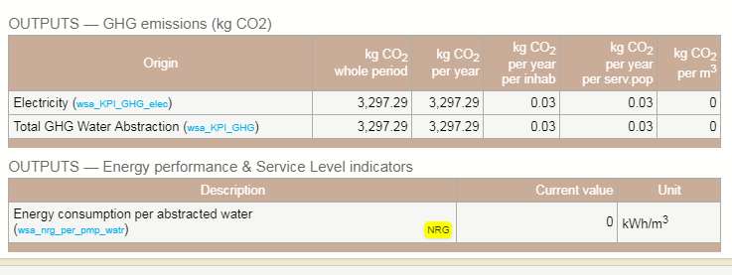
Assessing water efficiency in ECAM tool
Drinking Water Detailed GHG Assessment (Abstraction)
Module 6: Water Efficiency

Slide 22
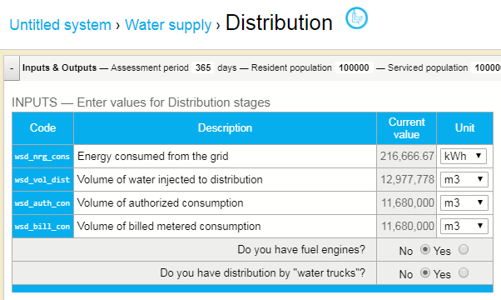
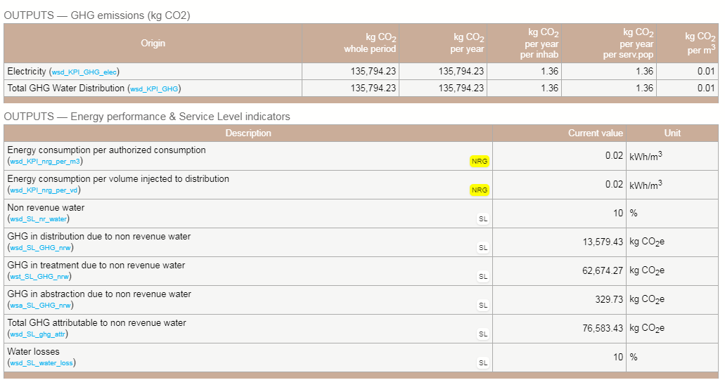
Assessing water efficiency in ECAM tool
Drinking Water Detailed GHG Assessment (Treatment)
Module 6: Water Efficiency

Slide 23
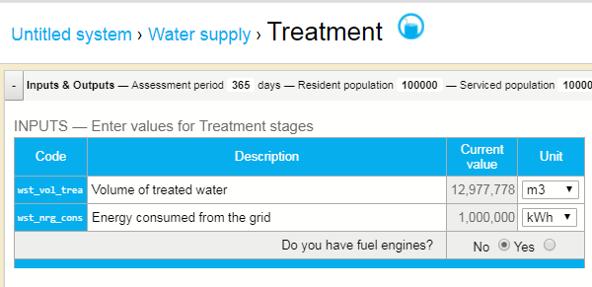
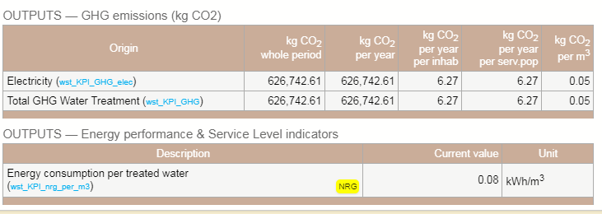
Assessing water efficiency in ECAM tool
Drinking Water Detailed GHG Assessment (Distribution)
Module 6: Water Efficiency

Slide 24
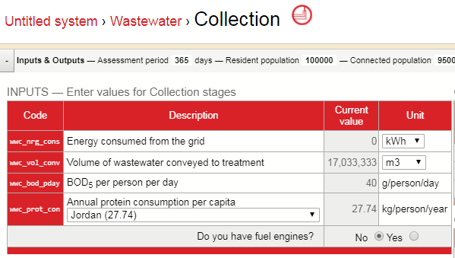
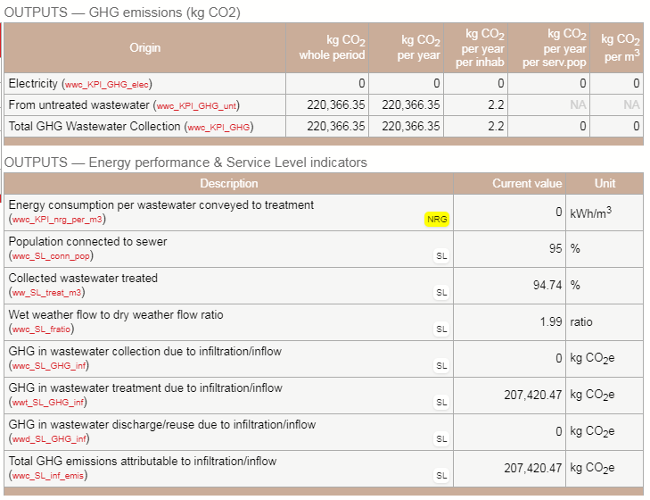
Assessing water efficiency in ECAM tool
Wastewater Detailed GHG Assessment (Collection)
Module 6: Water Efficiency

Slide 25
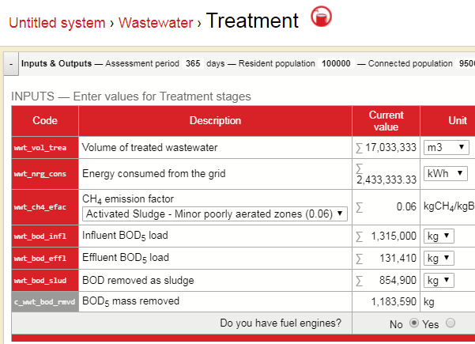
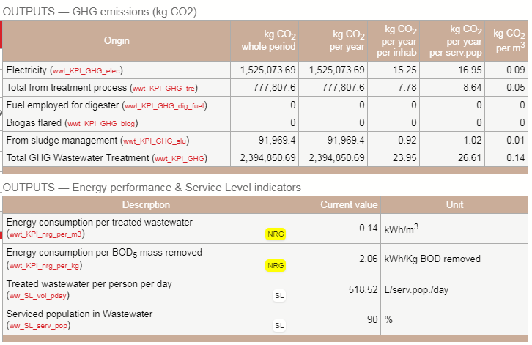
Assessing water efficiency in ECAM tool
Wastewater Detailed GHG Assessment (Treatment)
Module 6: Water Efficiency

Slide 26
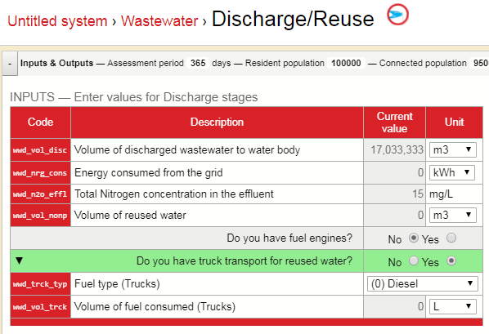
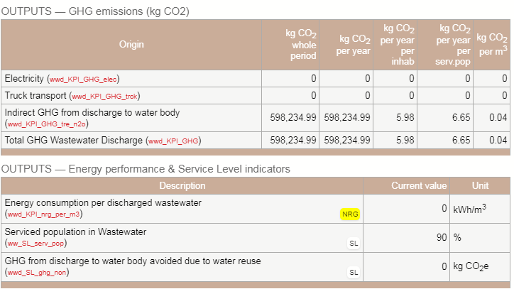
Assessing water efficiency in ECAM tool
Wastewater Detailed GHG Assessment (Discharge)
Module 6: Water Efficiency

Slide 27
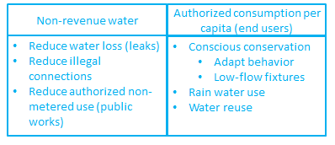
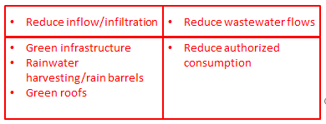
LEARNING EXERCISE
Exercise 4: Assessing water efficiency opportunities in ECAM
For each measure, indicate how you would assess, and what stages the measure would impact in terms of GHG emissions
Module 6: Water Efficiency

Slide 28
LEARNING EXERCISE
Exercise 5: Assessing water efficiency opportunities in ECAM
Use the kWh/m3 factor in Distribution Stage, and kg CO2e/kWh conversion factor for grid electricity specified in Configuration
Calculate what a 10% reduction in authorized consumption will result in GHG reduction from just the Distribution stage.
Develop the hand calculation for GHG emissions
Check with ECAM Opportunities page and/or other ECAM pages.
Module 6: Water Efficiency

Slide 29
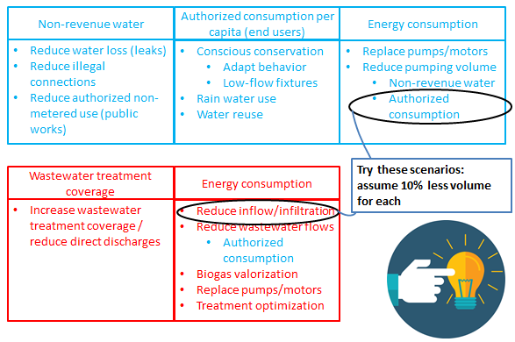
LEARNING EXERCISE
Exercise 6: Water efficiency opportunities
Module 6: Water Efficiency

Slide 30
LEARNING EXERCISE
Exercise 6: Water efficiency opportunities (Cont’d)
Module 6: Water Efficiency

Slide 31
RECAP
How does Water efficiency contribute to climate change?
How ECAM tool can be used to assess opportunities for improving water efficiency and reducing related GHG emissions
How does implementing water efficiency related measures to reduce GHG emissions fits within the WaCCliM Roadmap
Module 6: Water Efficiency

